Slide 1
MYSTIC FOREST
GAME RPG 2D

Slide 2
TABLE OF CONTENTS
01
02
03
WHY MAKE GAME 2D
Introduction about Mystic Forest
Tools

Slide 3
01
WHY MAKE GAME 2D

Slide 4
Choose make Game 2D
Easier to develop
Broader appeal
2D games generally require less complex programming and art creation compared to 3D games.
They often have a simpler and easier-to-learn gameplay style, which can appeal to a wider range of gamers, including casual gamers.
Greater creative freedom
2D art allows for a lot of creativity and variety. You can create unique and stylized visuals that wouldn't be possible with 3D graphics.

Slide 5
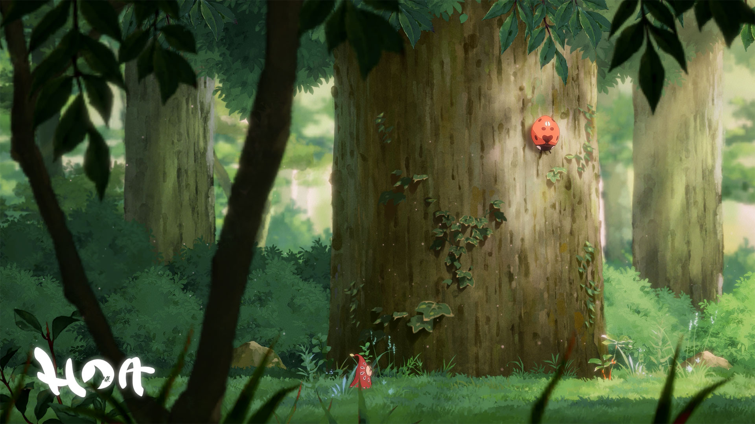
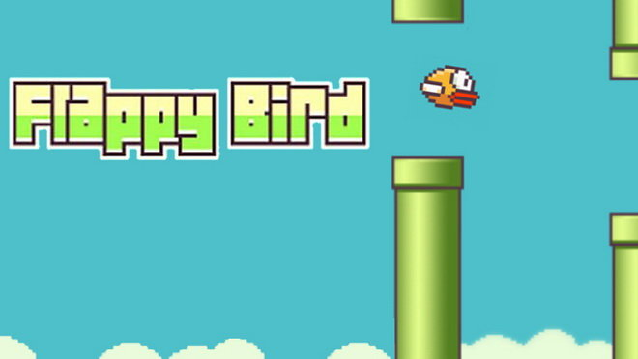
Some games were developed in Vietnam
Hoa is a beautiful puzzle-platforming game that features breathtaking hand-painted art, lovely music, and a peaceful, relaxing atmosphere.
Flappy Bird is a side scrolling game, like the popular game Super Mario Brothers, where the player controls a bird in a 2D environment. Unlike Mario, the player only has control over the bird's vertical movement. The main goal is for the bird to travel as far as it can without hitting any green pipes.

Slide 6
02
Introduction about Mystic Forest

Slide 7
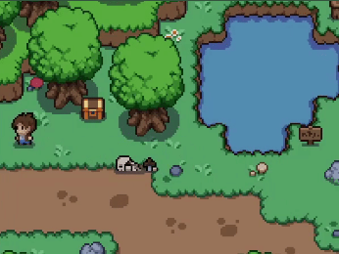
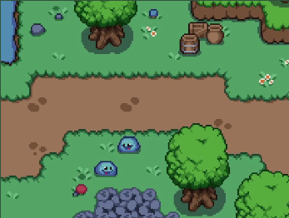
Introduction
Game Title: Mystic Forest
Genre: Role-Playing Game (RPG)
Gameplay: Play as an adventurer on a quest to rescue a princess who has been captured within a mysterious forest. Defeat the monsters that lurk in the woods, collect coins, and gather items to aid you on your journey.

Slide 8
03
Tools

Slide 9



TOOLS

